Slide 1
Role of DevOps in SDLC
Prashant Nandipati & Lekha Grace
Notes:
Good evening everyone, Today’s talk will be about Role of Devops in Software Development Lifecycle.

Slide 2


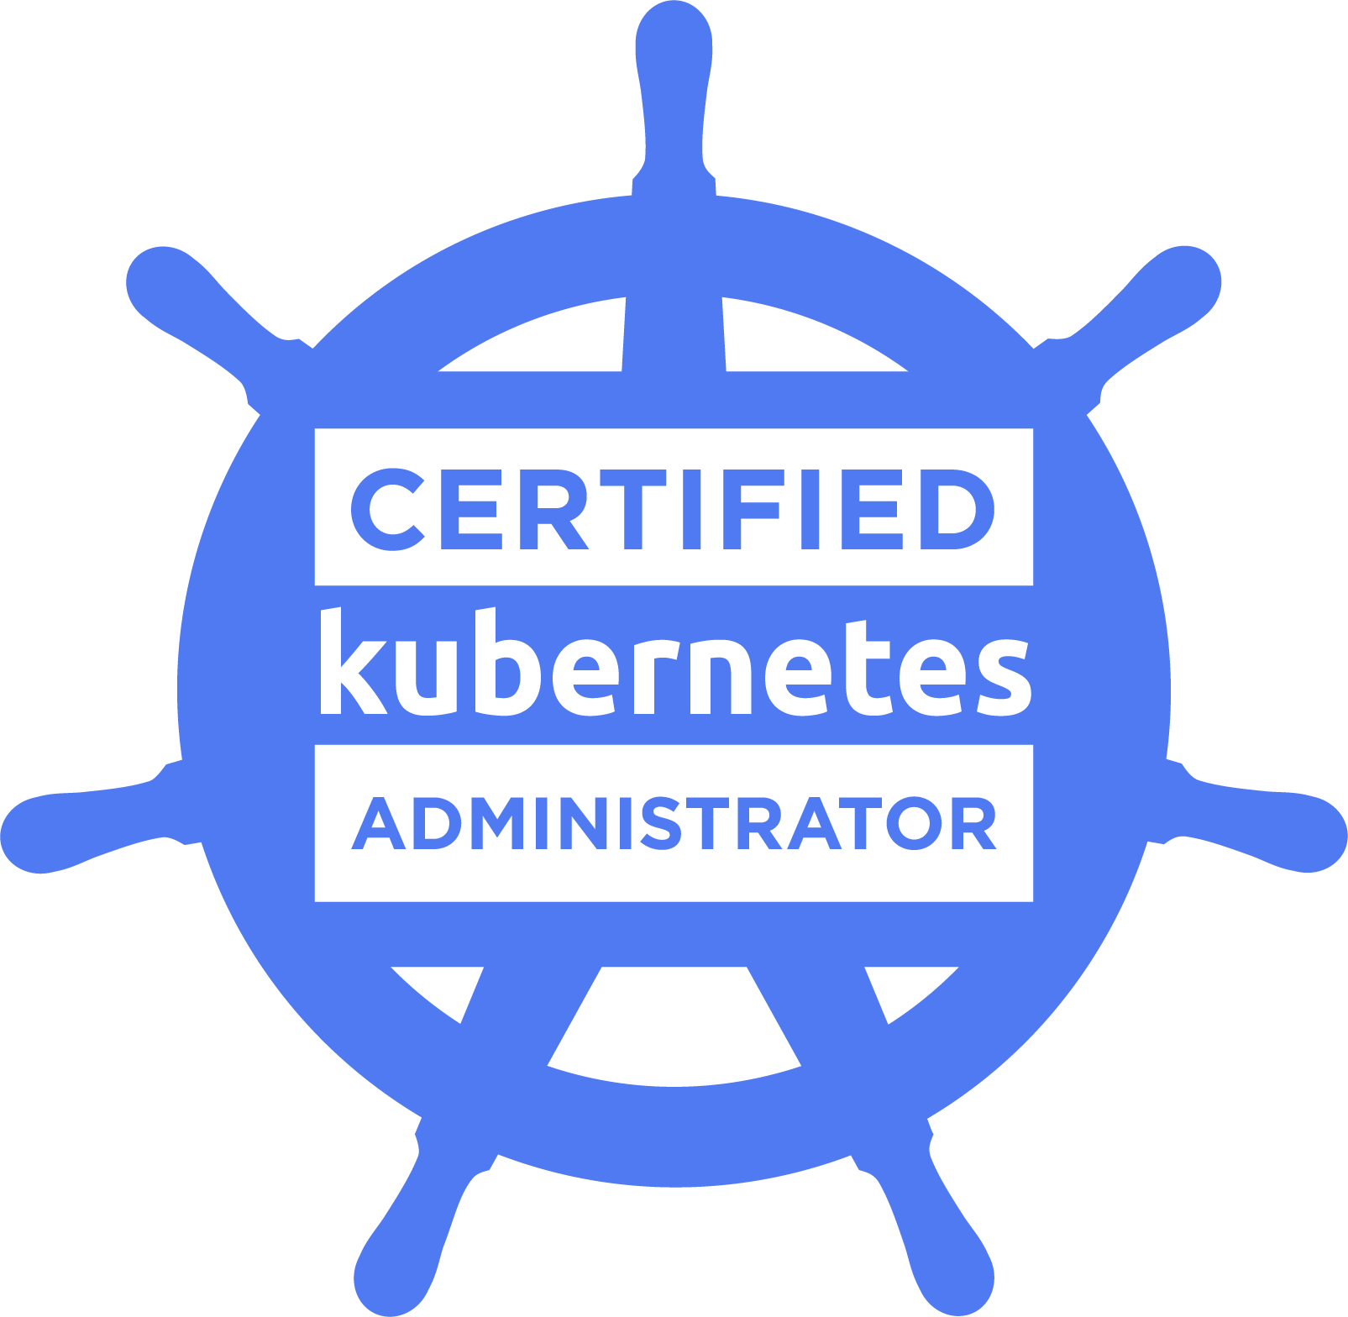
$ whoami
Prashant_Nandipati
$ whereis ./work
Devops Engineer
https://prashantnook.in
Notes:
Before that some information about me, I am Prashant, I am a Certified Kubernetes Administrator working at Zigram as a Junior Devops Engineer. (maybe say this) As matter of fact this is the first time I am presenting a topic infront of audience so I am extremely grateful for the organisers for giving me a chance.

Slide 3
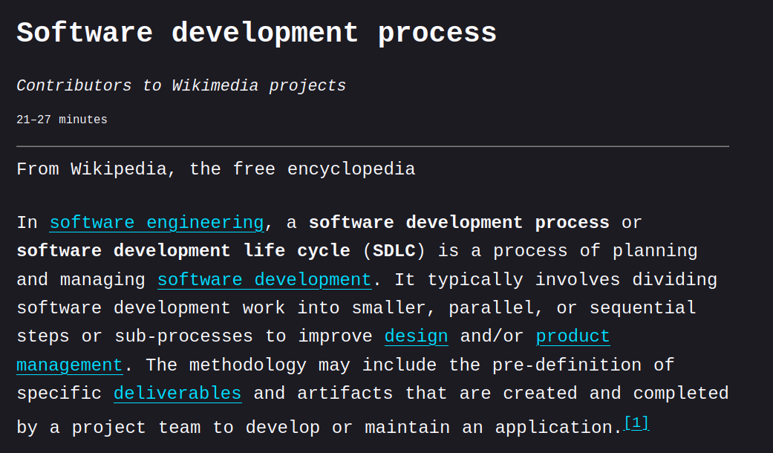

What is SDLC
`Software Development Life Cycle`
https://en.wikipedia.org/wiki/Software_development_process
Notes:
So coming to the talk, What is Software Development Lifecycle, If we do a quick Search on Wikipedia this is what we will be getting.
Basically what we understand is
The software development life cycle - cost-effective and time-efficient - development teams - design and build software by splitting them into smaller steps - one after the other - parallely. This methodology - series of steps - divide the software development process - smaller tasks - assign, complete, and measure.
So far this makes pretty good sense but why is it important, Why can’t I just develop and deploy as is just as how I do for testing. It is how it is done before pre-internet. I am not that old. I know thats how it was done.

Slide 4
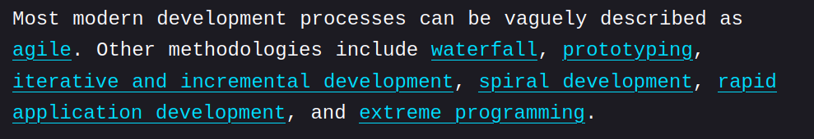
SDLC Methodologies
Concept
Deliverable
System
Analysis
Design
Code
Testing
Ops
https://en.wikipedia.org/wiki/Software_development_process
Notes:
Various methodologies that we follow
Agile
Waterfall
Iterative
Spiral
Waterfall:
The waterfall model arranges all the phases sequentially so that each new phase depends on the outcome of the previous phase. Conceptually, the design flows from one phase down to the next, like that of a waterfall.
Agile:
Several Development Cycles.
Iterates Rapidly - delivering small increment changes
Continuously change requirement plans based on results
The agile model arranges the SDLC phases into several development cycles. The team iterates through the phases rapidly, delivering only small, incremental software changes in each cycle. They continuously evaluate requirements, plans, and results so that they can respond quickly to change. The agile model is both iterative and incremental, making it more efficient than other process models.
System and software requirements: captured in a product requirements document
Analysis: resulting in models, schema, and business rules
Design: resulting in the software architecture
Coding: the development, proving, and integration of software
Testing: the systematic discovery and debugging of defects
Operations: the installation, migration, support, and maintenance of complete systems

Slide 5
SDLC Methodologies :: Waterfall
Deliverable
Notes:
Various methodologies that we follow
Agile
Waterfall
Iterative
Spiral
Waterfall:
The waterfall model arranges all the phases sequentially so that each new phase depends on the outcome of the previous phase. Conceptually, the design flows from one phase down to the next, like that of a waterfall.

Slide 6
SDLC Methodologies :: Agile
Deliverable
Deliverable
Deliverable
Deliverable
Notes:
Agile:
Several Development Cycles.
Iterates Rapidly - delivering small increment changes
Continuously change requirement plans based on results
The agile model arranges the SDLC phases into several development cycles. The team iterates through the phases rapidly, delivering only small, incremental software changes in each cycle. They continuously evaluate requirements, plans, and results so that they can respond quickly to change. The agile model is both iterative and incremental, making it more efficient than other process models.

Slide 7
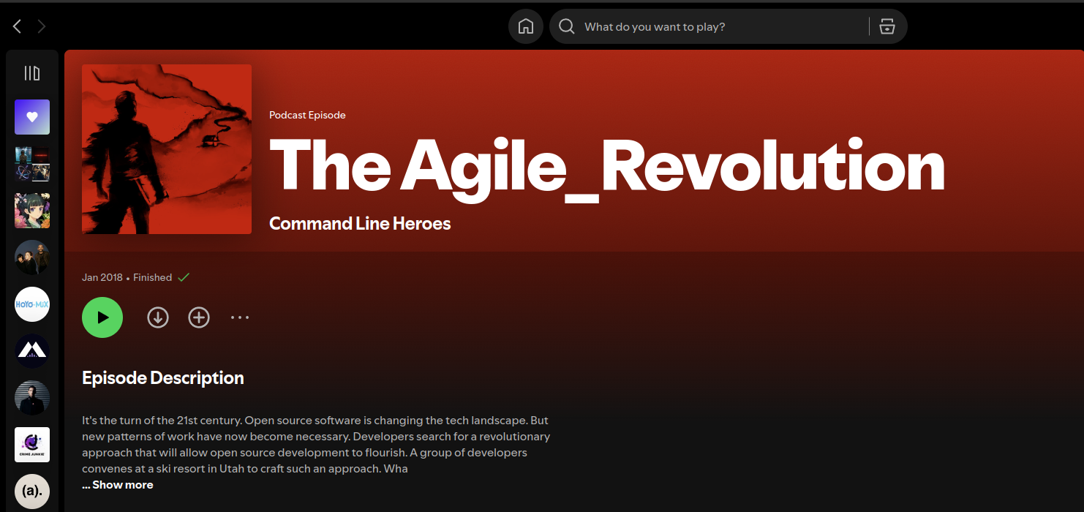

SDLC Methodologies :: Agile :: Sidenote
Notes:
Agile:
Several Development Cycles.
Iterates Rapidly - delivering small increment changes
Continuously change requirement plans based on results
The agile model arranges the SDLC phases into several development cycles. The team iterates through the phases rapidly, delivering only small, incremental software changes in each cycle. They continuously evaluate requirements, plans, and results so that they can respond quickly to change. The agile model is both iterative and incremental, making it more efficient than other process models.

Slide 8
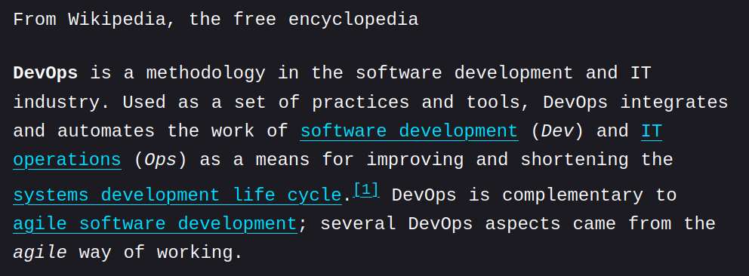
DevOps in SDLC
https://en.wikipedia.org/wiki/DevOps
Notes:
What is Devops
DevOps
Practices
tools
philosophy
automate and integrate the processes between software development and IT teams.
It emphasizes - cross-team communication - collaboration - automation.

Slide 9
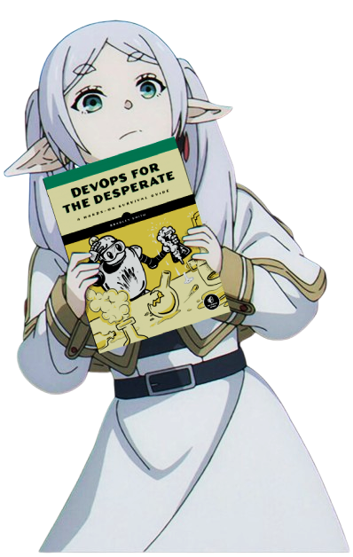
What’s Devops
Notes:
What is Devops
DevOps
Practices
tools
philosophy
automate and integrate the processes between software development and IT teams.
It emphasizes - cross-team communication - collaboration - automation.

Slide 10
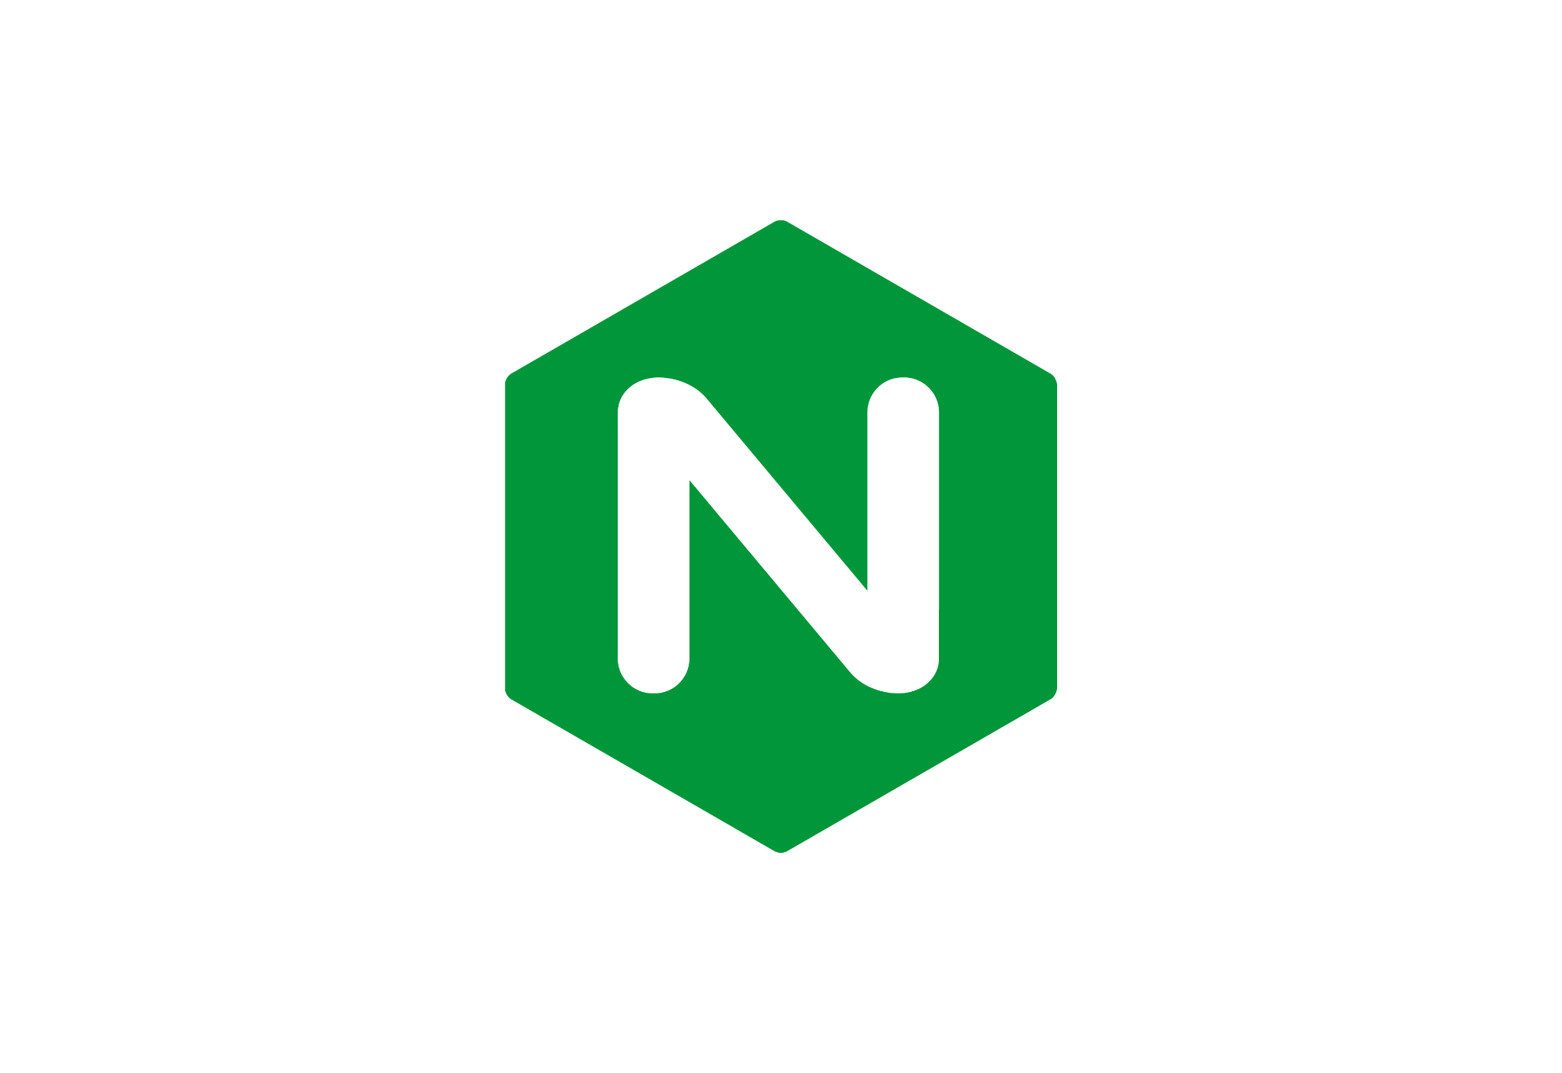

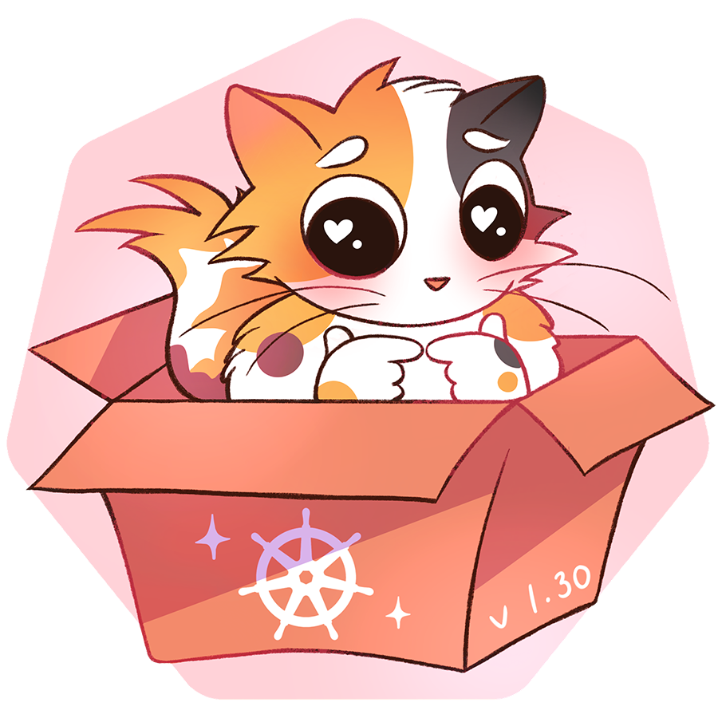
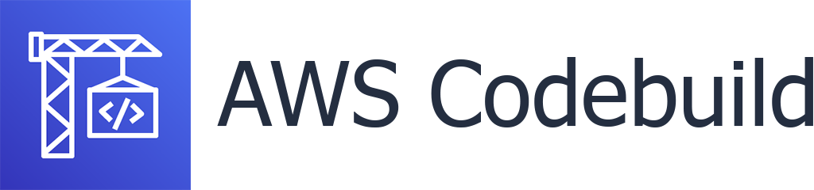


Devops
CI/CD
86c91940
SCM
Deliver
Deploy
CI
Registry
Notes:
a set of practices intended to reduce the time between committing a change to a system and the change being placed into normal production,
Onprem .. explain where

Slide 11
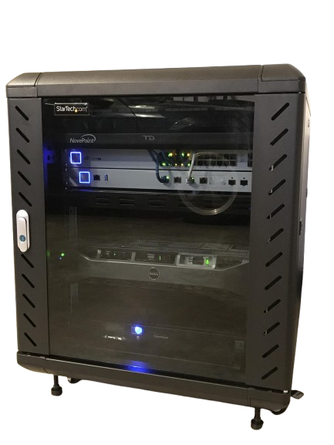
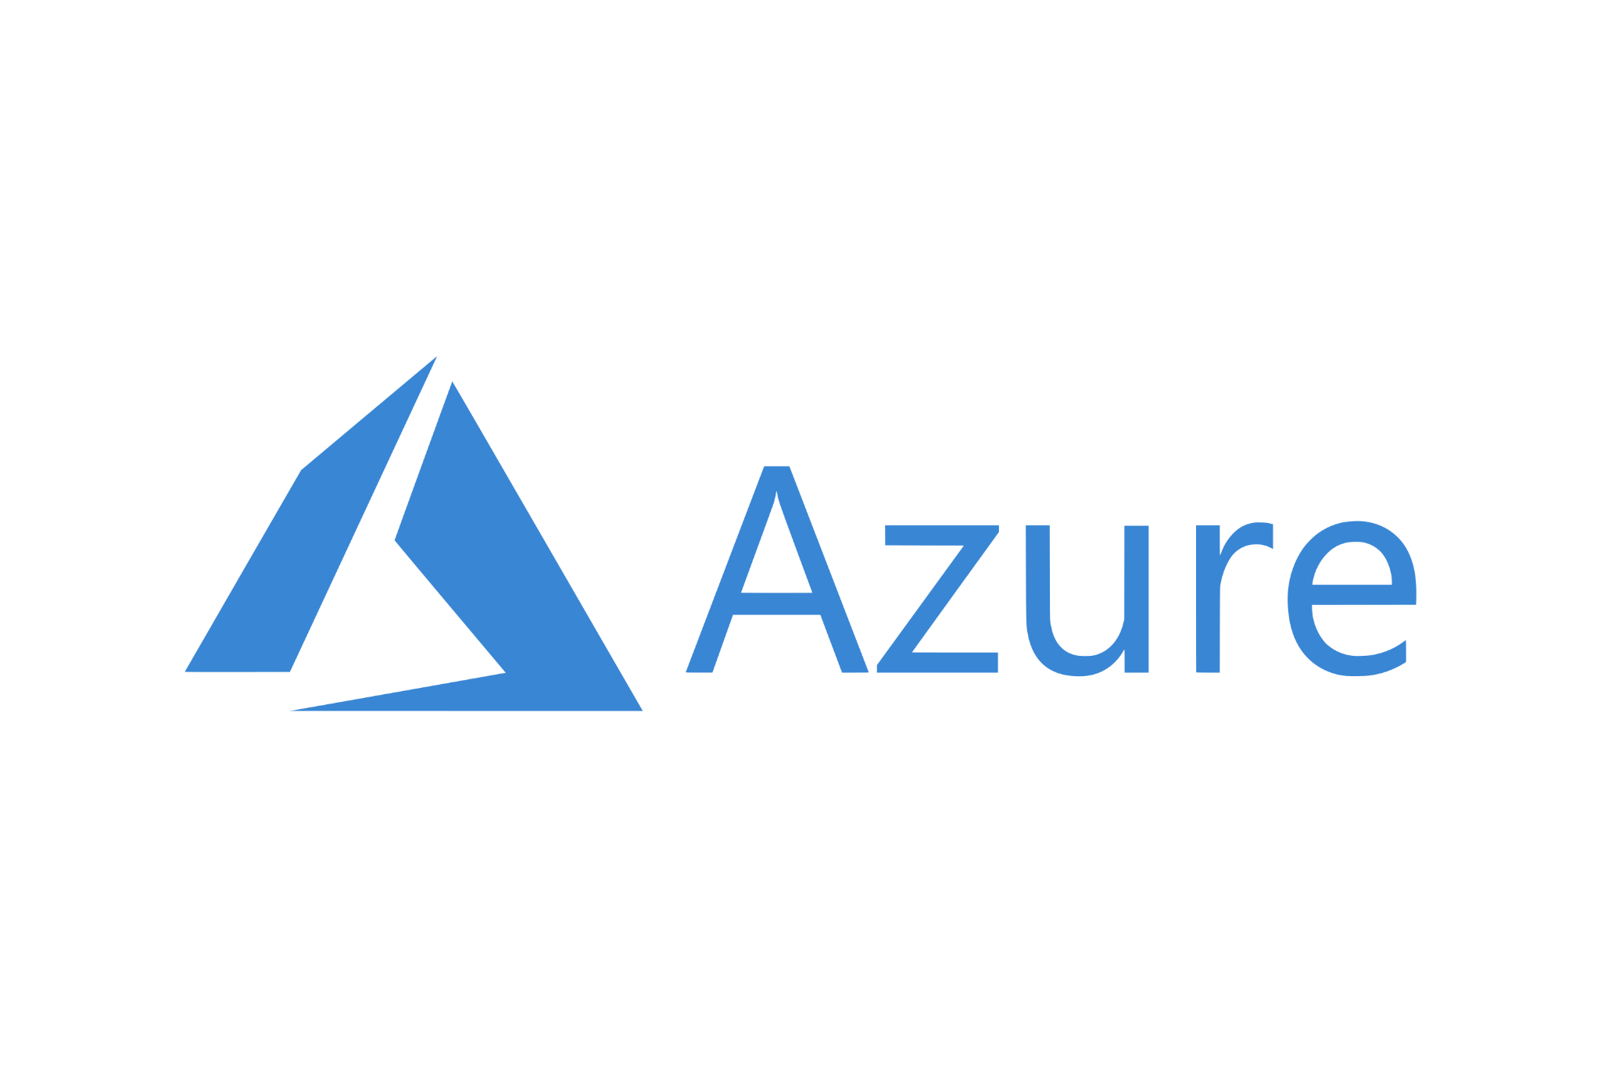
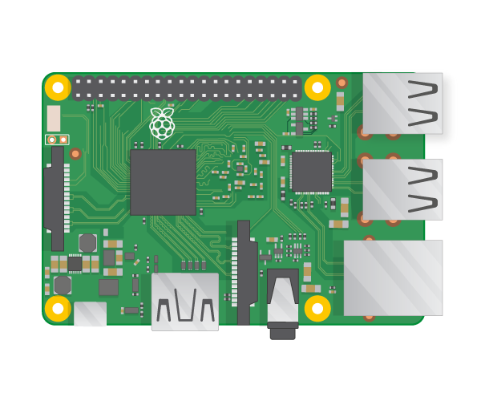



Devops :: Deployments
OnPrem
Cloud
Notes:
What is Onprem and what are clouds
Onprem ; managing your own infra, os, base hardware provisioning
Cloud ; Cloud does the managing for os
Only have to manage the things from os and above
Managed services

Slide 12
Devops :: Pipeline
CI/CD
86c91940
SCM
Deliver
Deploy
CI
Registry
Notes:
a set of practices intended to reduce the time between committing a change to a system and the change being placed into normal production,
Onprem .. explain where

Slide 13



Devops :: SCM
86c91940
Source Control:
Version Control
Branching

Slide 14
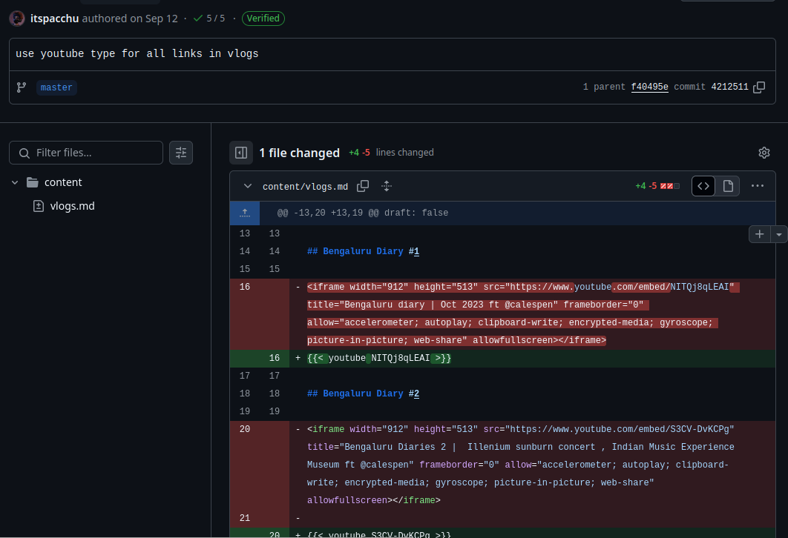

CI/CD
86c91940

Slide 15
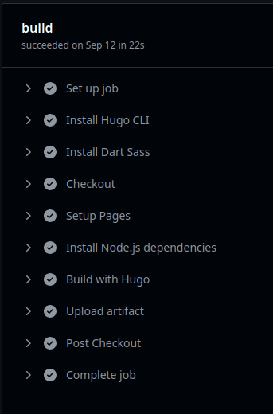
CI/CD
86c91940

Slide 16
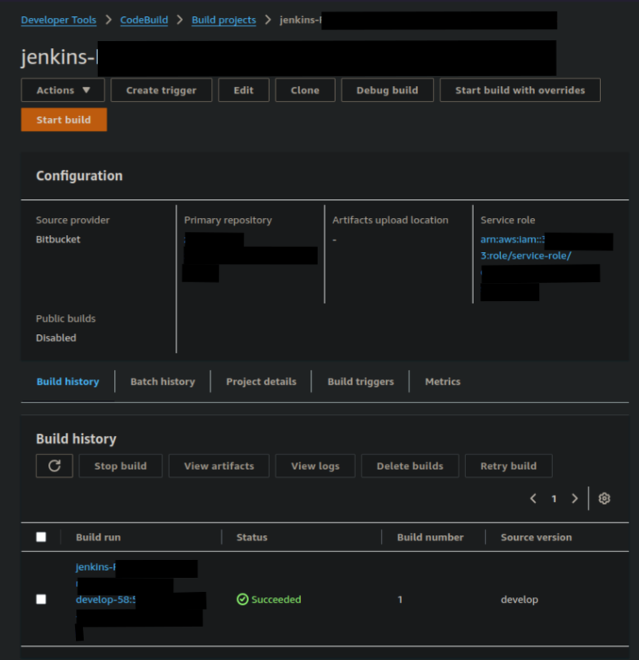

CI/CD :: CI
86c91940

Slide 17
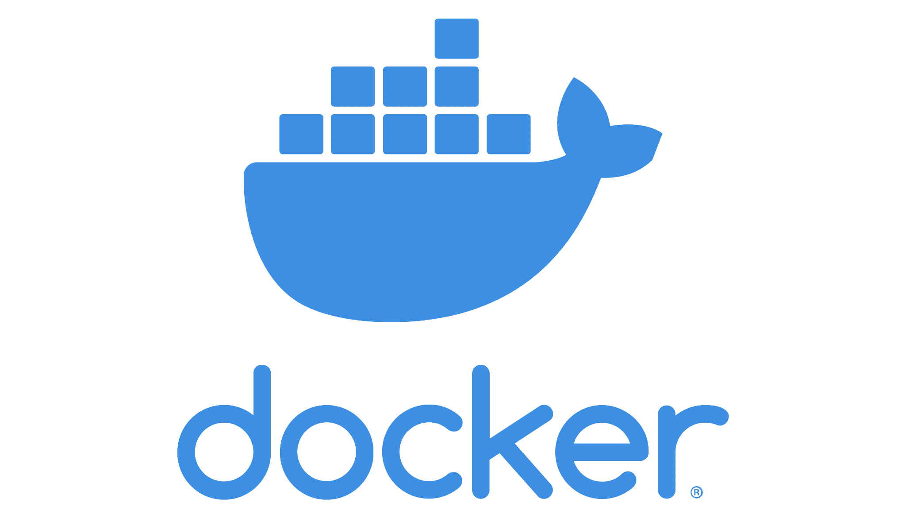


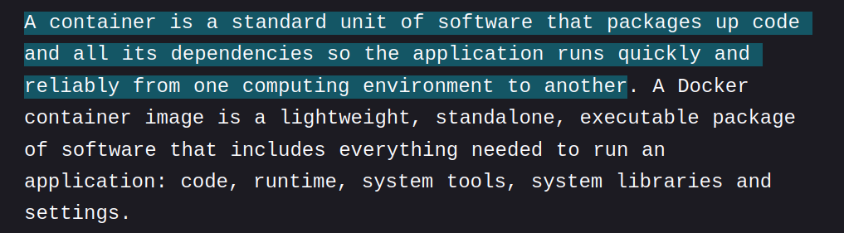
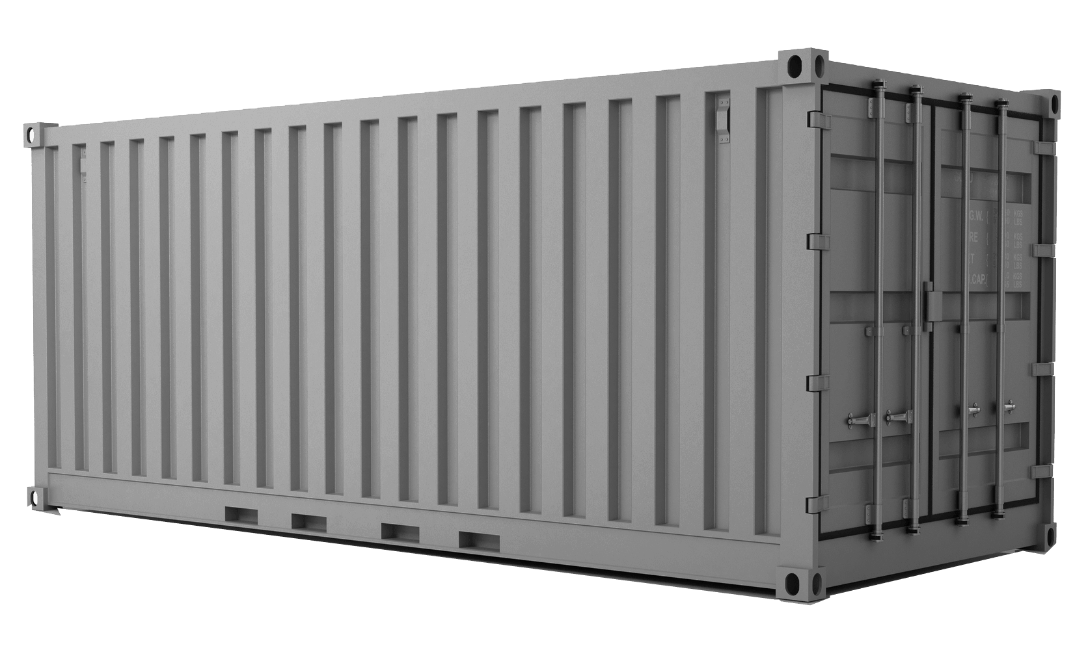
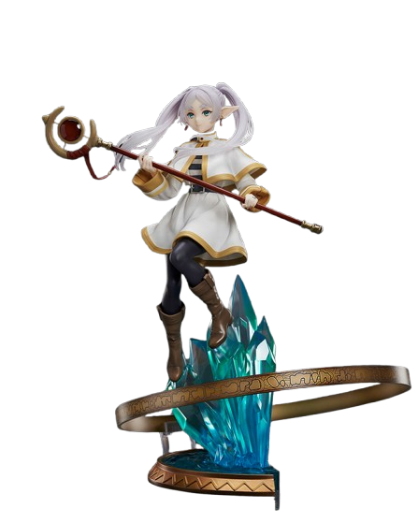


Containers
https://www.docker.com/resources/what-container/

Slide 18
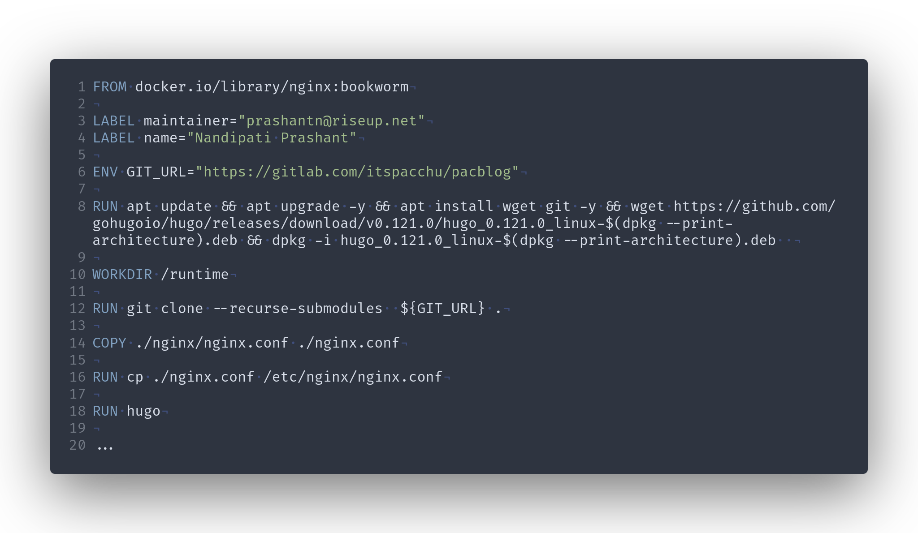




Containers
registry.gitlab.com/itspacchu/pacblog:arm89
nginx.conf
git clone … ${GIT_URL}

Slide 19
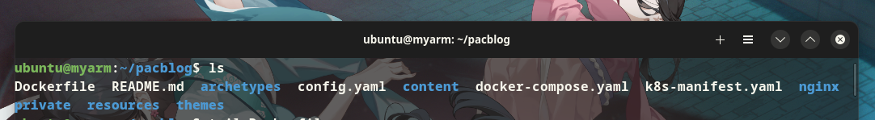
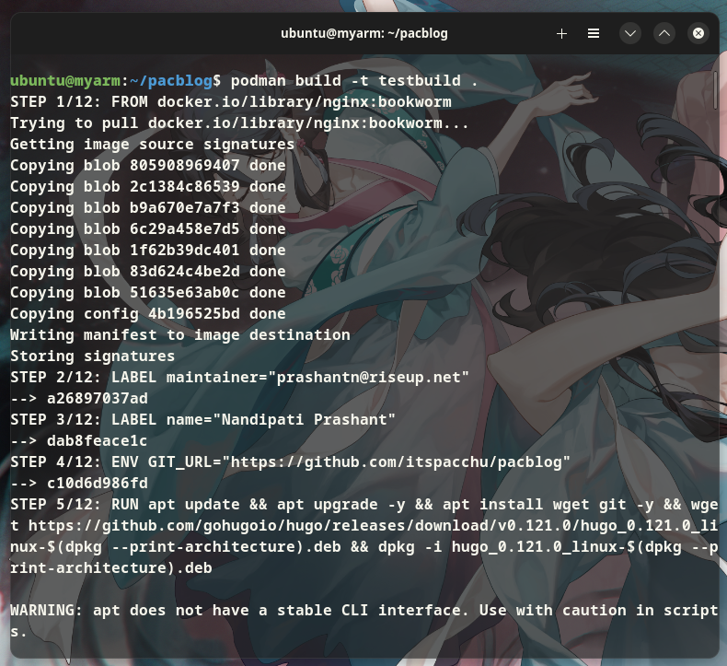
Containers
registry.gitlab.com/itspacchu/pacblog:arm89

Slide 20
Containers
https://www.docker.com/resources/what-container/

Slide 21
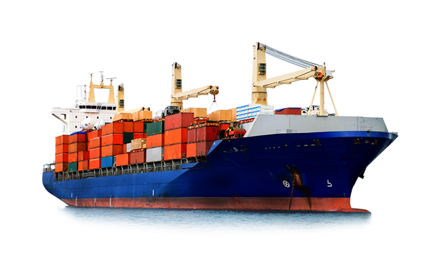
Containers
https://www.docker.com/resources/what-container/

Slide 22
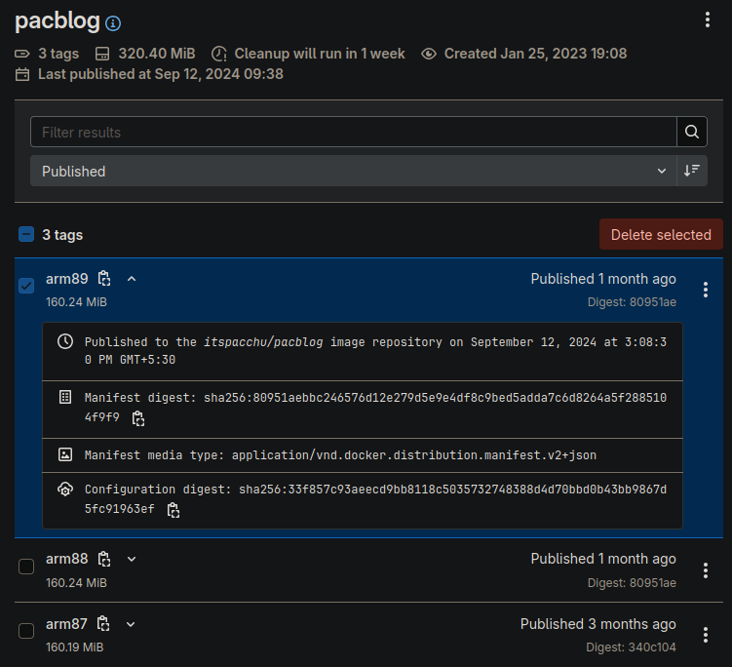
Registries
86c91940

Slide 23
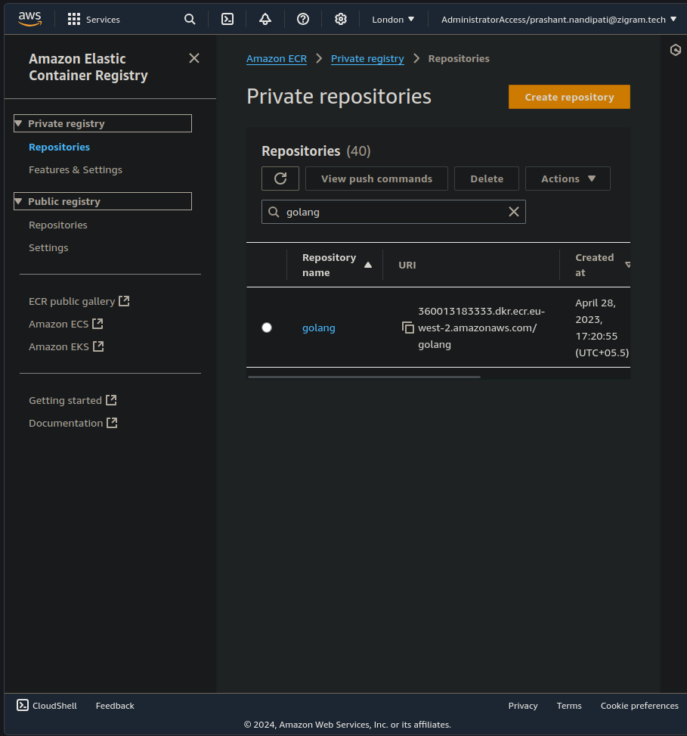
Registries
86c91940

Slide 24
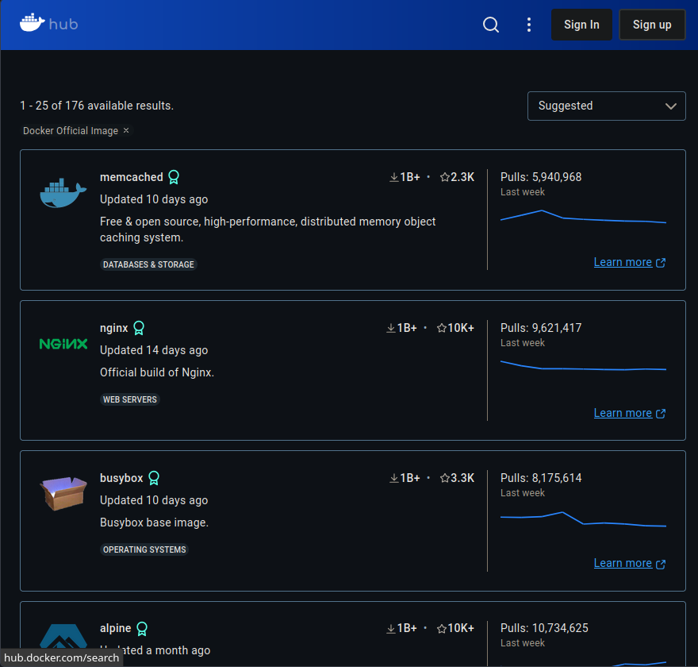
Registries
86c91940

Slide 25
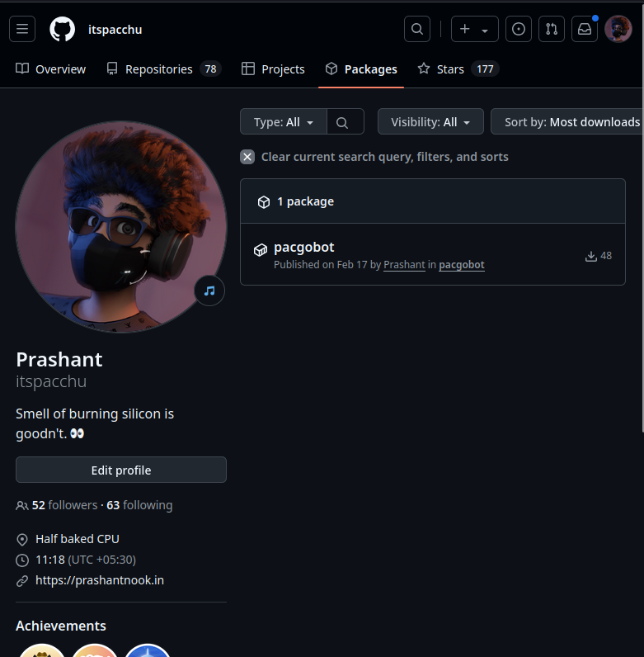
Registries
86c91940

Slide 26
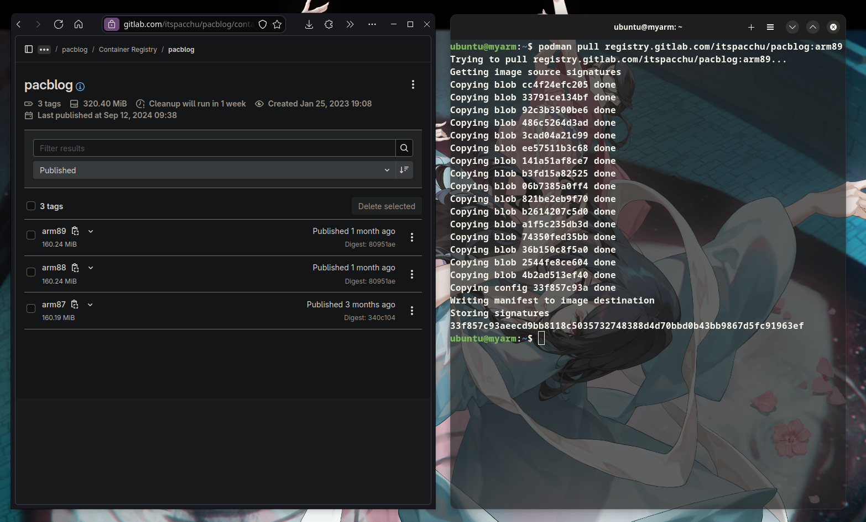




Container :: Stuff
86c91940
Pacblog Images are for Aarch64
*
Ubuntu on Raspberry PI
**
…
*Apple Silicon Macs’ ** Requires Root Access
Notes:
Curious Test out my blog locally on your machine

Slide 27
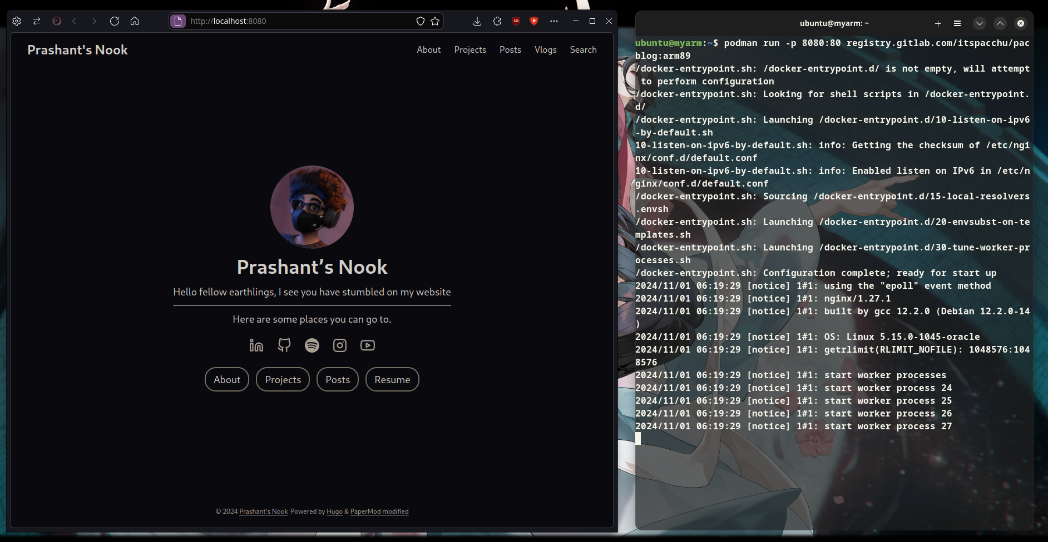
Container :: Stuff
86c91940
Notes:
Curious Test out my blog locally on your machine
Show QR for website to talk about replication 200 people hitting website

Slide 28
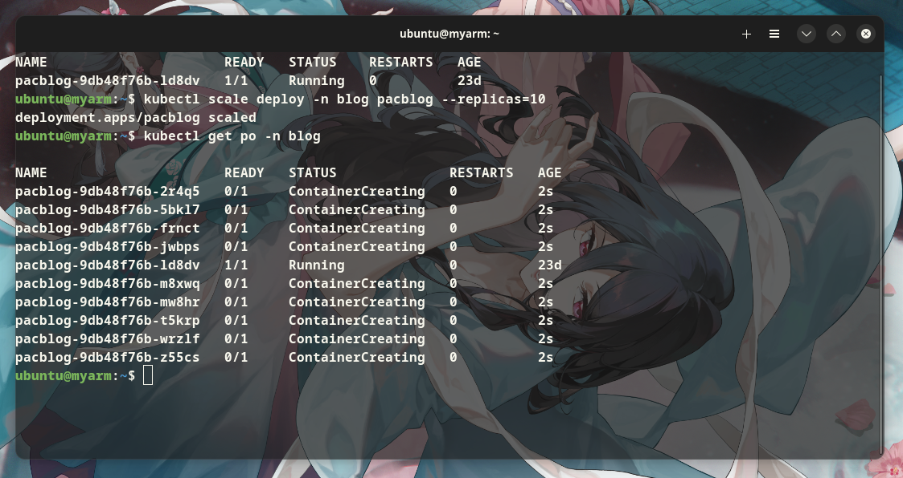
Container(s) :: Stuff
86c91940
Notes:
Curious Test out my blog locally on your machine
Show QR for website to talk about replication 200 people hitting website

Slide 29


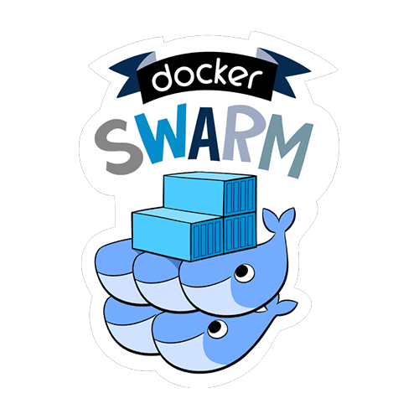

Container Orchestration
86c91940

Slide 30
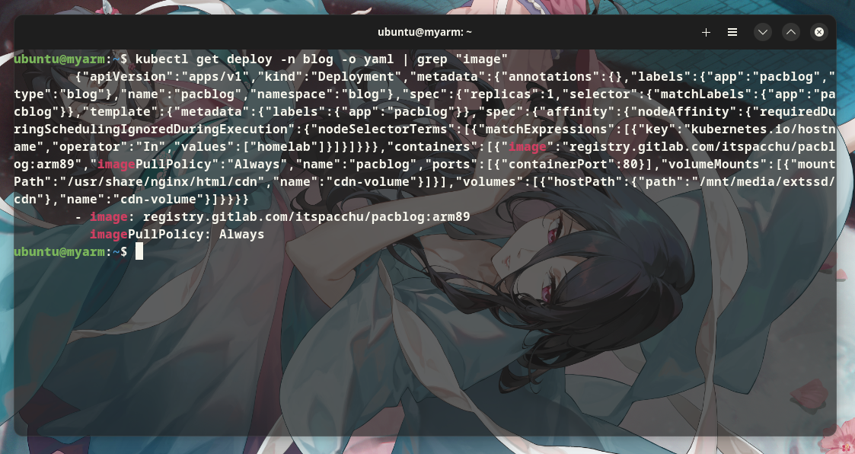
Container Orchestration
86c91940

Slide 31
Kubernetes :: Overview
86c91940
PacControlPlane
PacNode01
Pod
Pod
Key Value DB
Pod
Scheduler
Manager
Pod
Pod
Pod
PacNode03
API server
proxy
kubelet
PacNode02

Slide 32


Load Balancer
86c91940
prashantnook.in
DNS :: Cloudflare
10.15.xx.xx
Nginx
PacControlPlane
Minecraft
NAS…

Slide 33
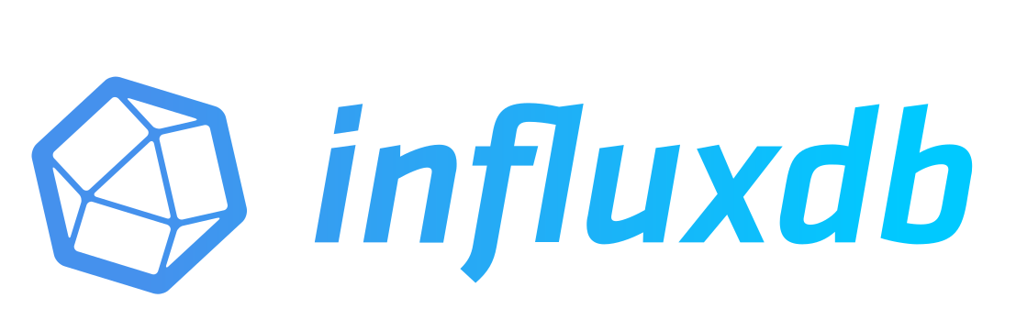




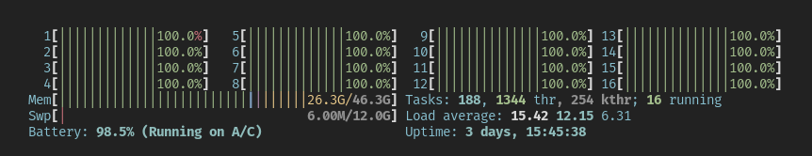
Monitoring!
86c91940

Slide 34
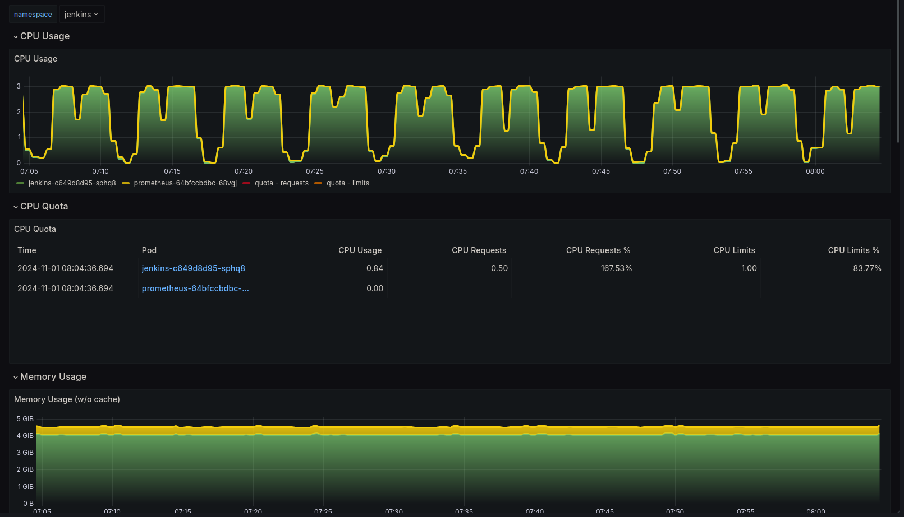
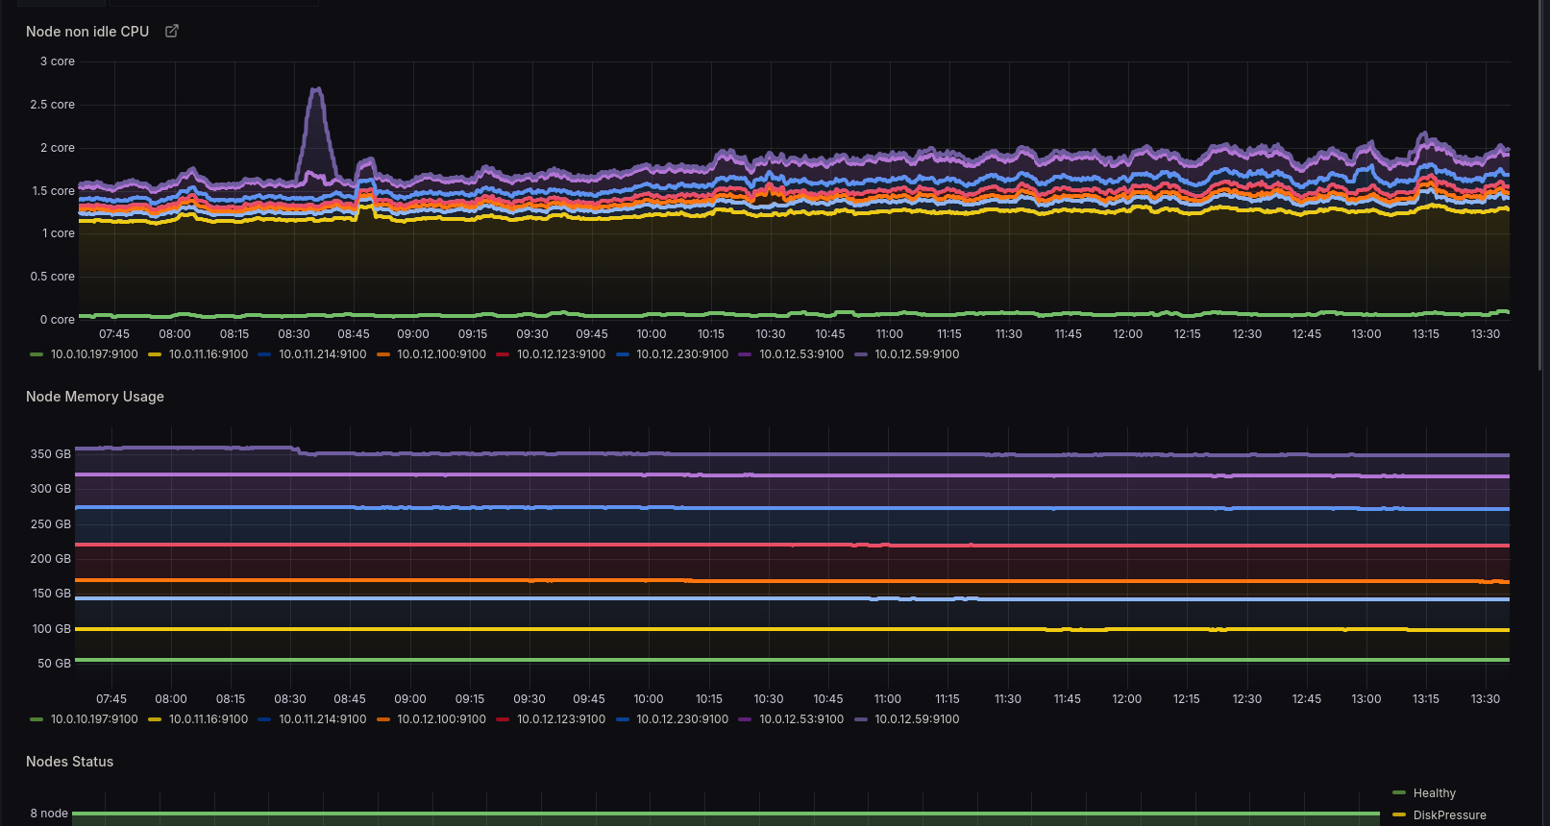
Monitoring :: Grafana

Slide 35
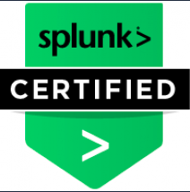
$ whoami
Lekha Grace
$ whereis ./work
Splunk Engineer
Notes:
RE

Slide 36

Monitoring :: Splunk

